Slide 1
Underwater Image Enhancement
Aaron Yangello and Singyan Yuen

Slide 2

Overview
Algorithm
Results
Discussion and Comparison
Conclusions!

Slide 3

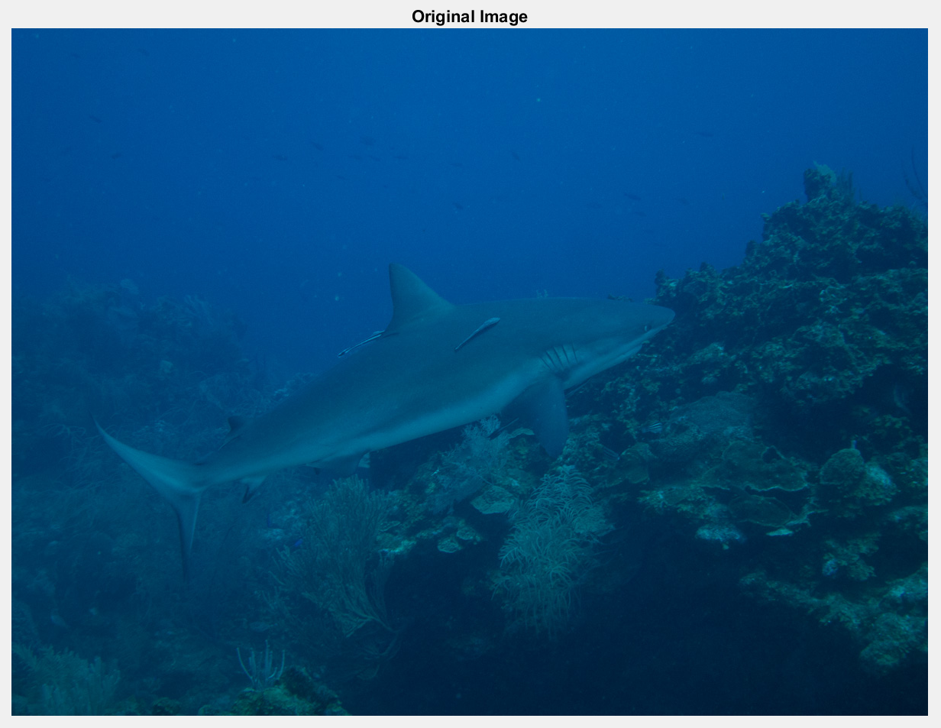
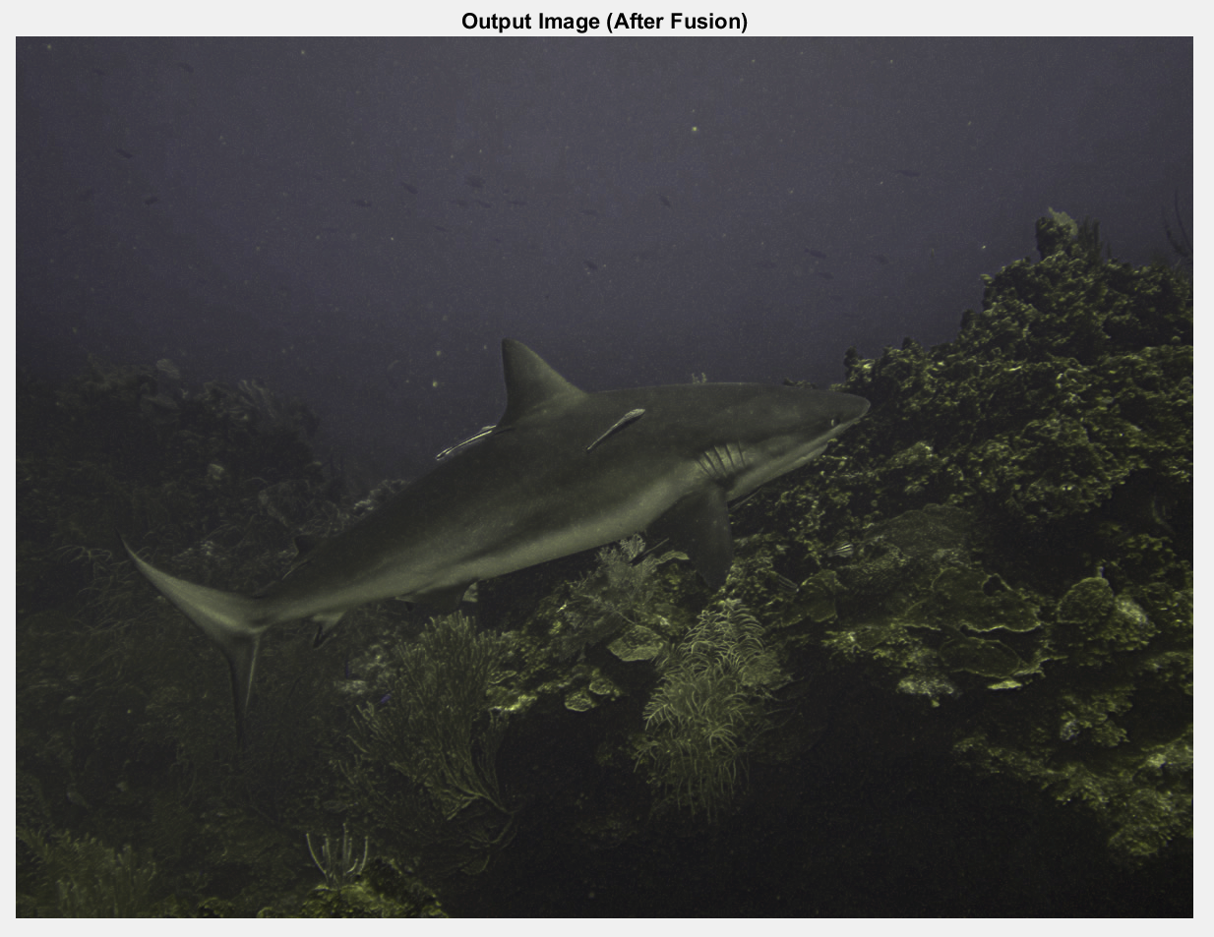
What?

Slide 4
How?
Color Correction
Dehazing
Gamma Correction
White Balance
Multi-Scale
Fusion
INPUT
OUTPUT
Sharpening

Slide 5
White Balance
Compensate Red Channel with Fraction of Green
Primarily Compensate Heavily Attenuated Pixels

Slide 6
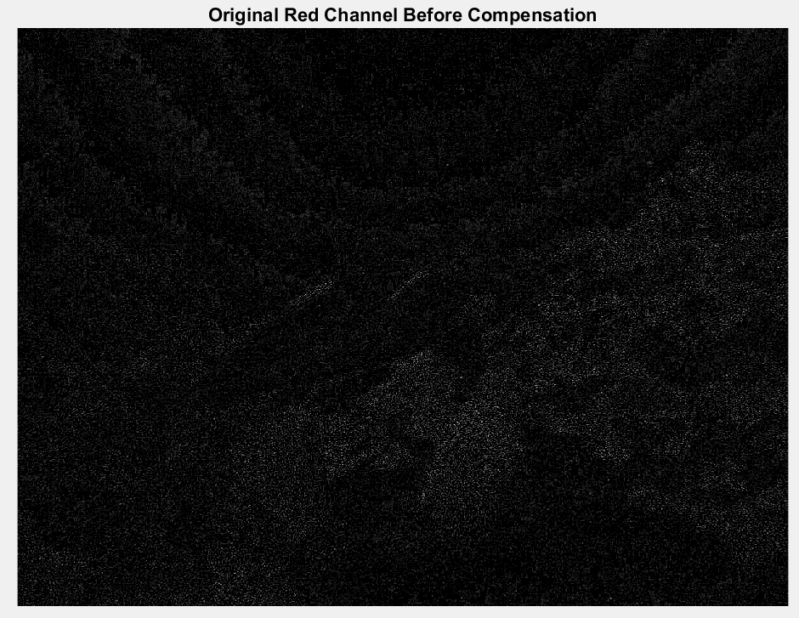
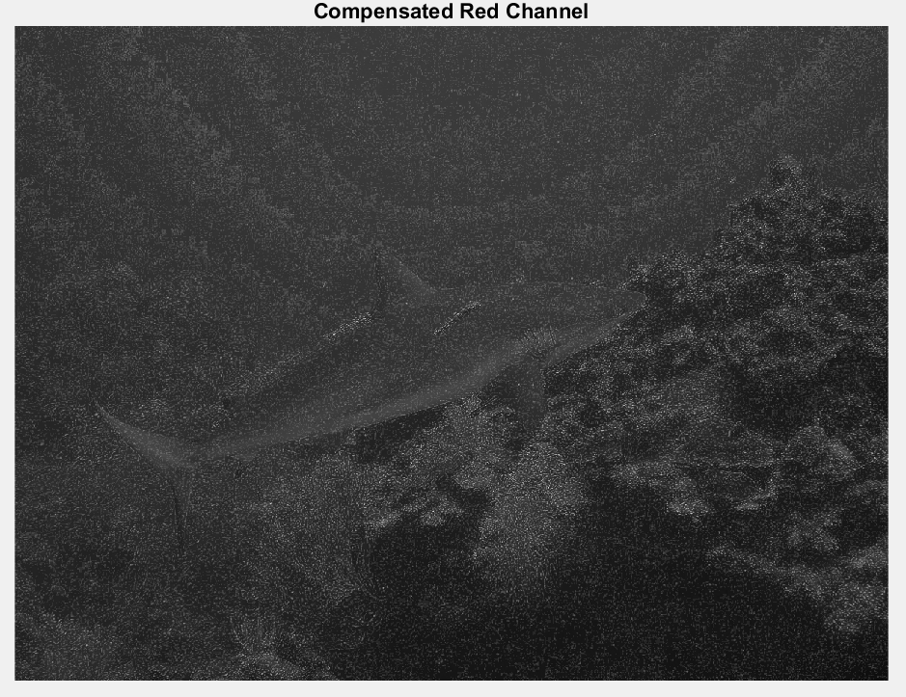
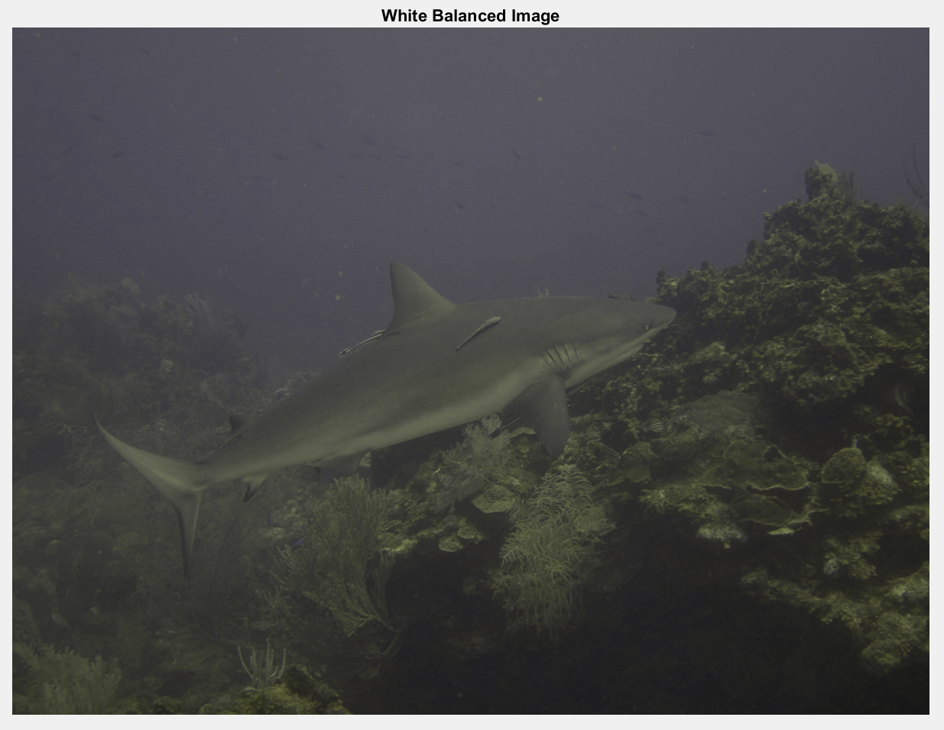
White Balance
Original Image
Original Red Channel
Compensated Red Channel
White Balanced Image

Slide 7
Dehazing
Gamma Correction and Unsharp Mask
Weight Map Calculation
Laplacian Contrast
Saliency
Saturation
Multi-Scale Fusion
Laplacian Pyramid on Images
Gaussian Pyramid on Weight Maps

Slide 8
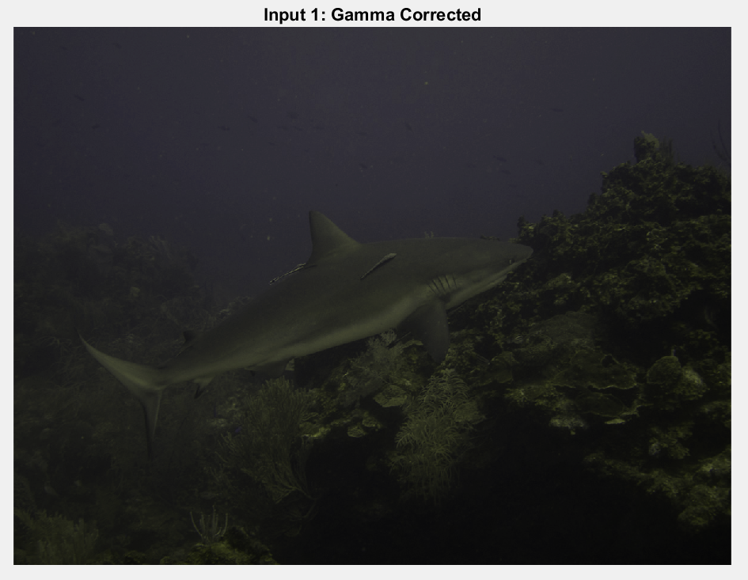
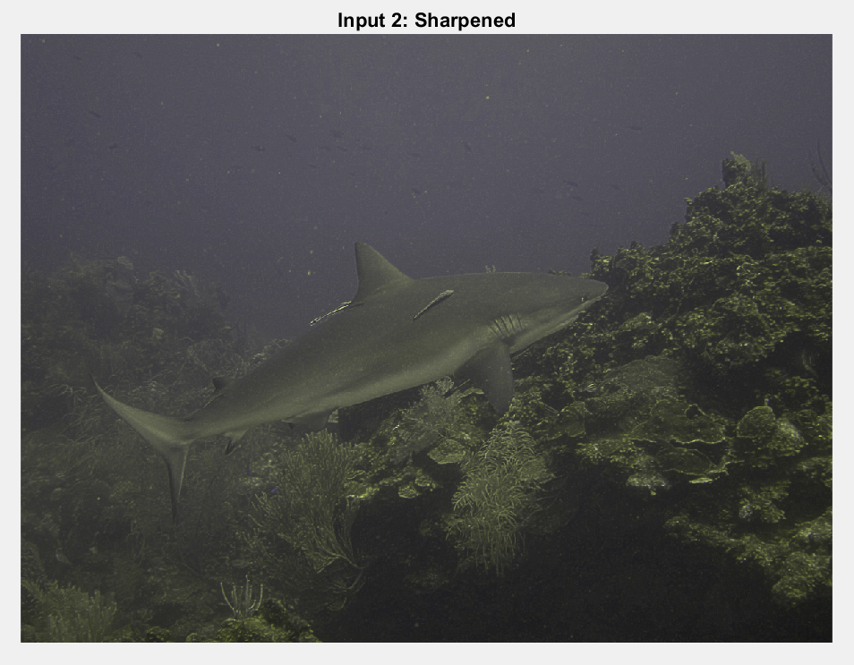
Dehazing
Gamma Correction
Unsharp Mask

Slide 9
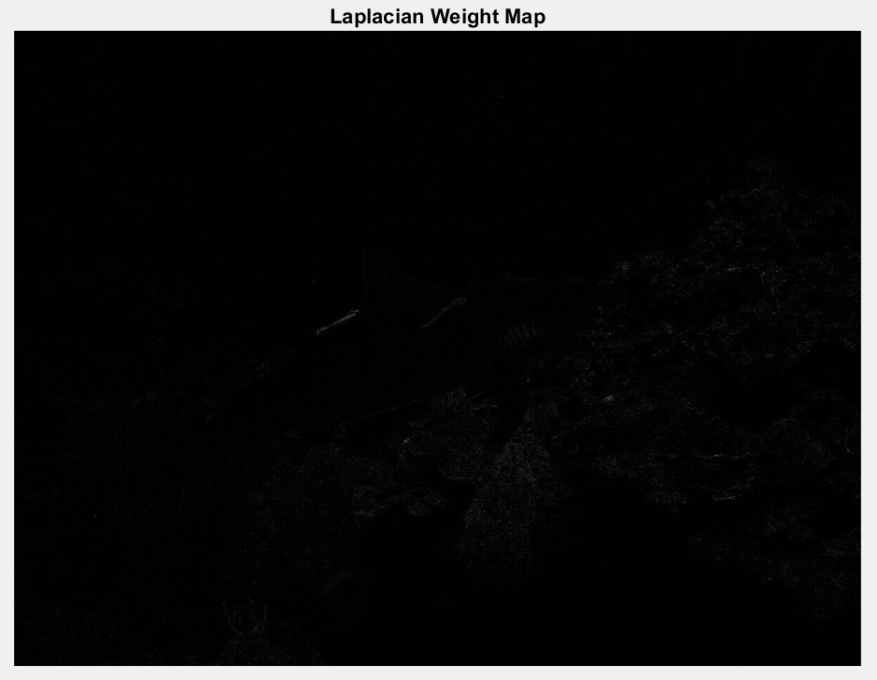
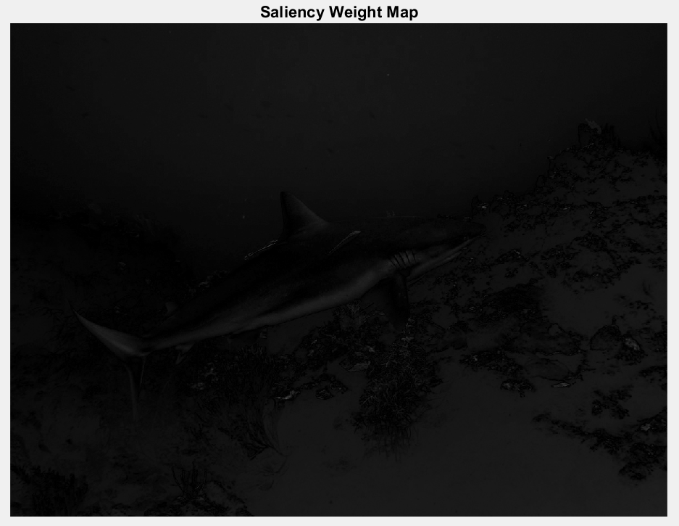
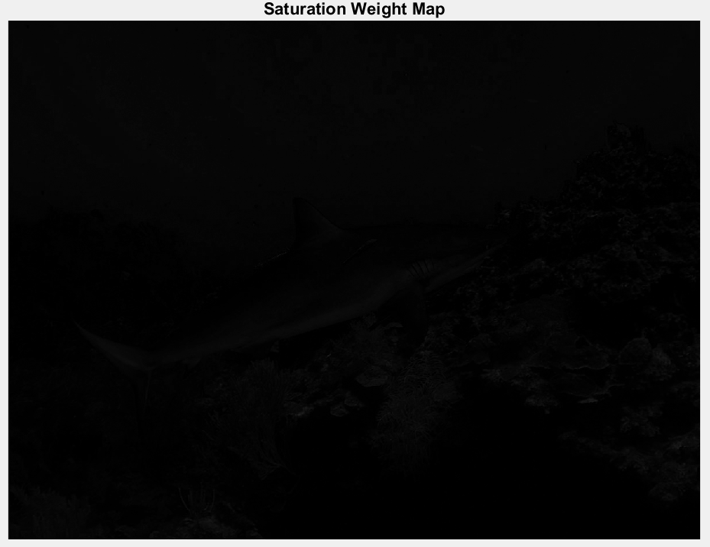
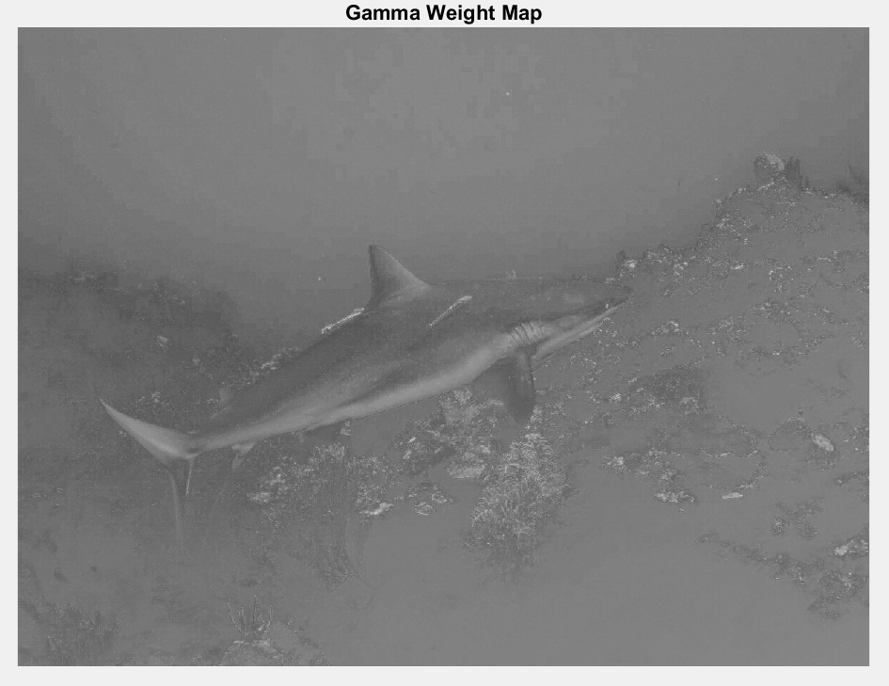
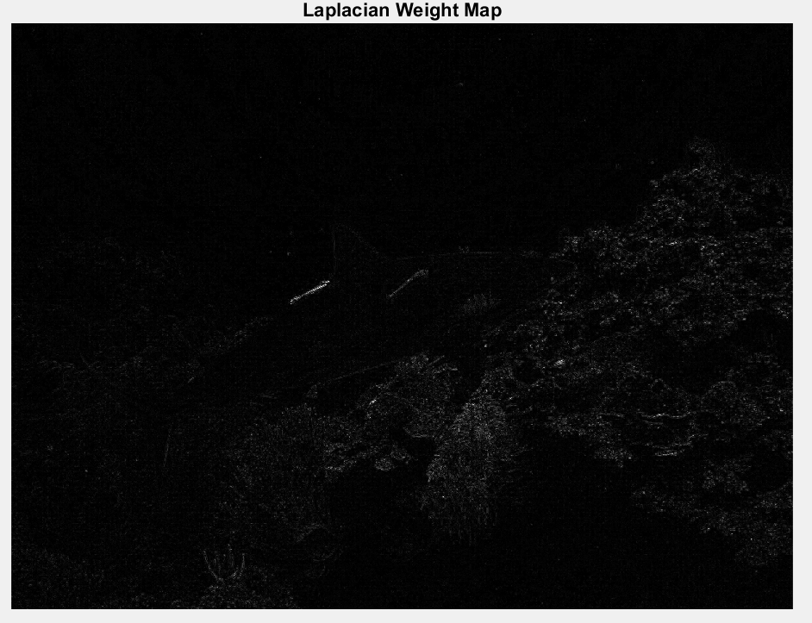
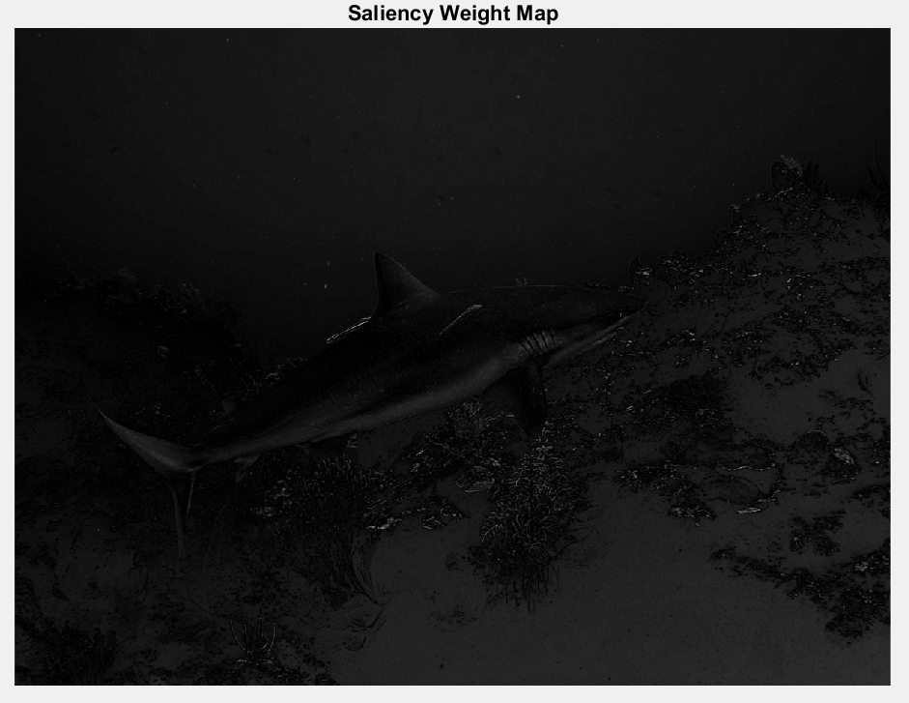
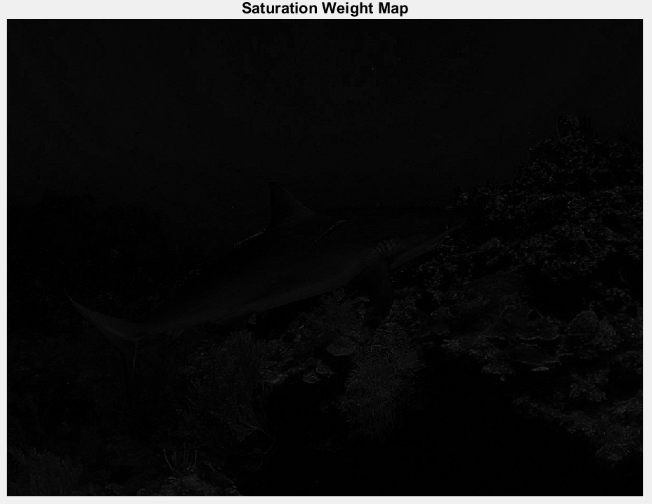
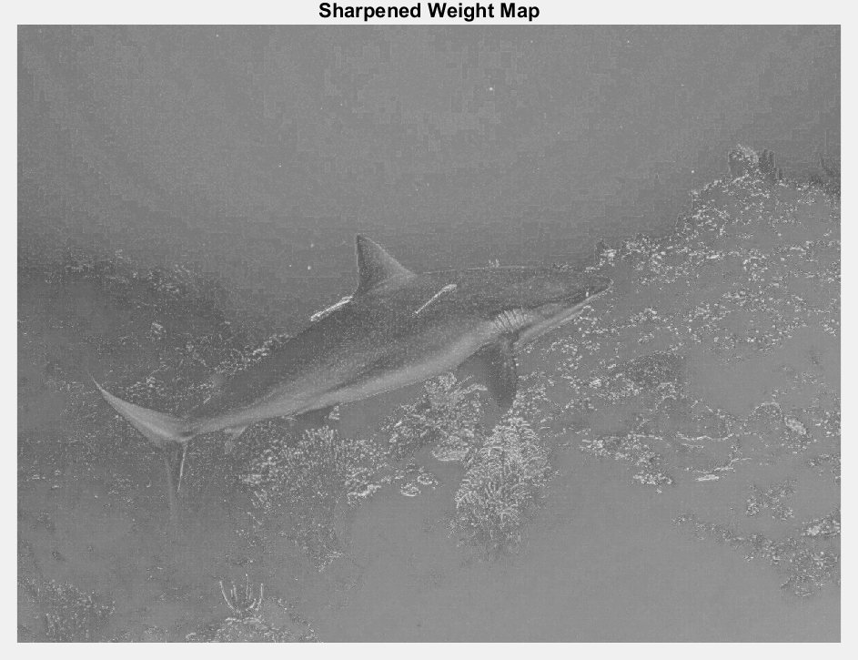
Dehazing
Gamma Corrected
Laplacian
Saliency
Saturation
Merged
Unsharp Mask
Laplacian
Saliency
Saturation
Merged

Slide 10
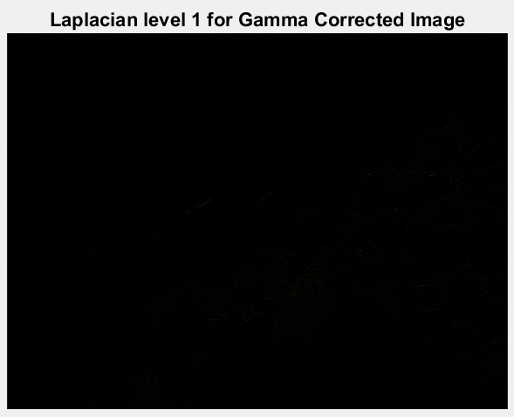
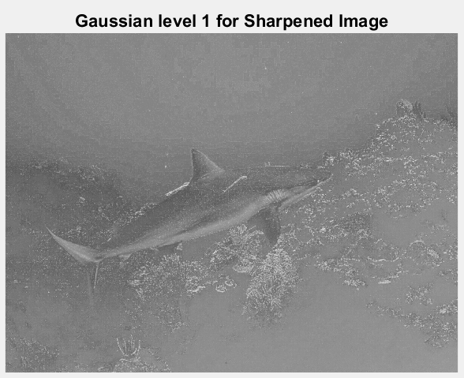
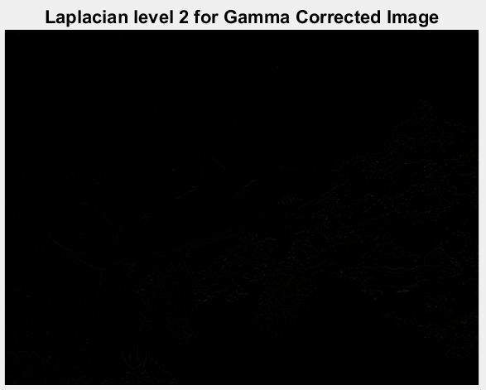
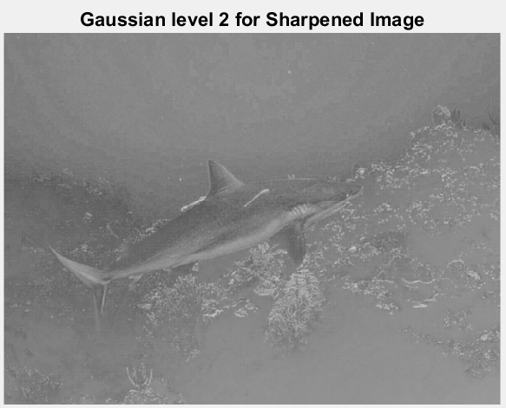
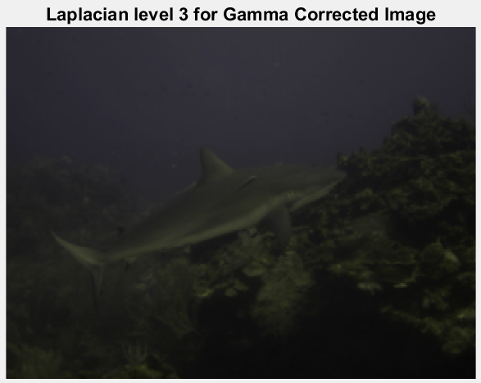
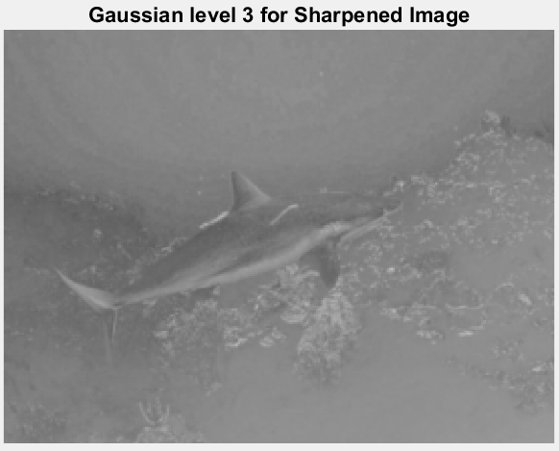
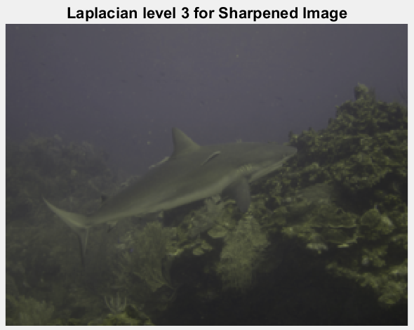
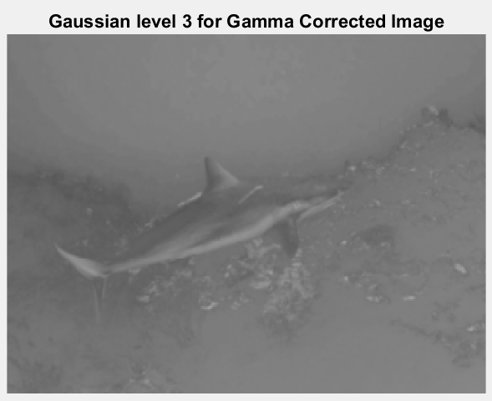
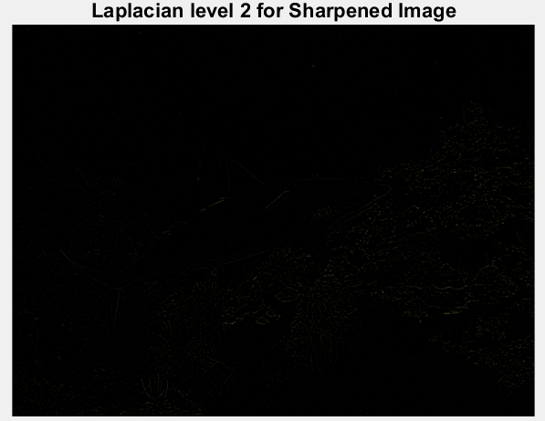
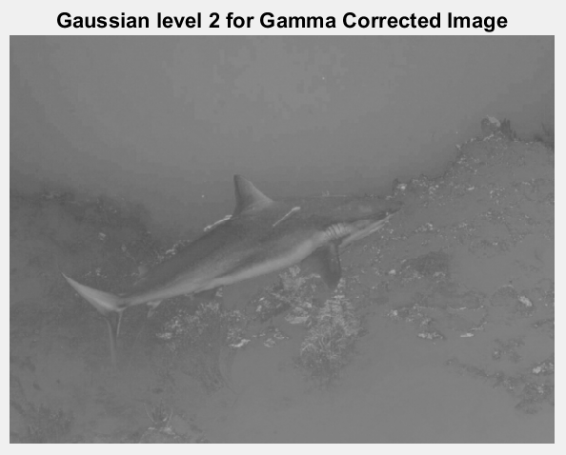
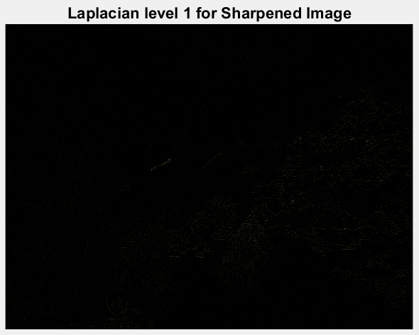
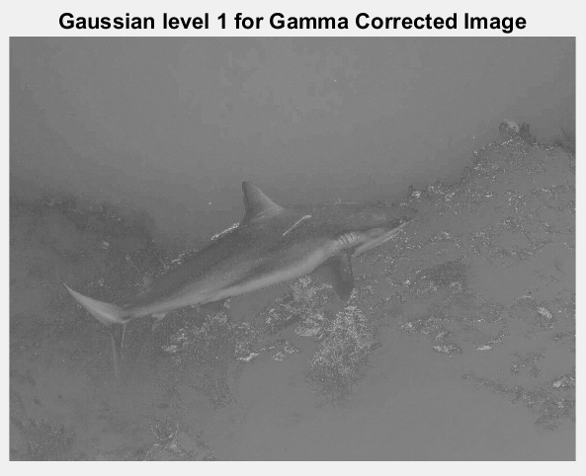
Pyramids!
Gamma Laplace
Gamma Gaussian
Sharpened Laplace
Sharpened Gaussian

Slide 11
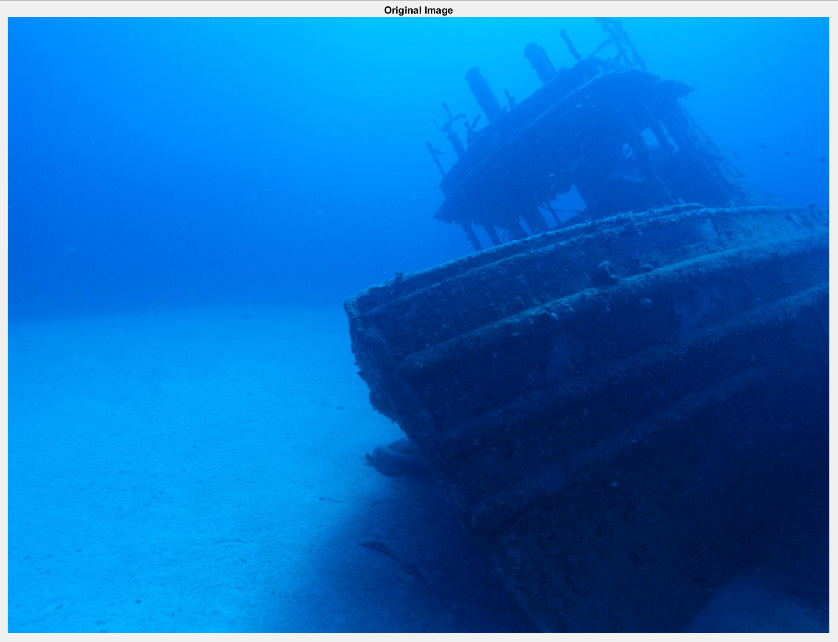
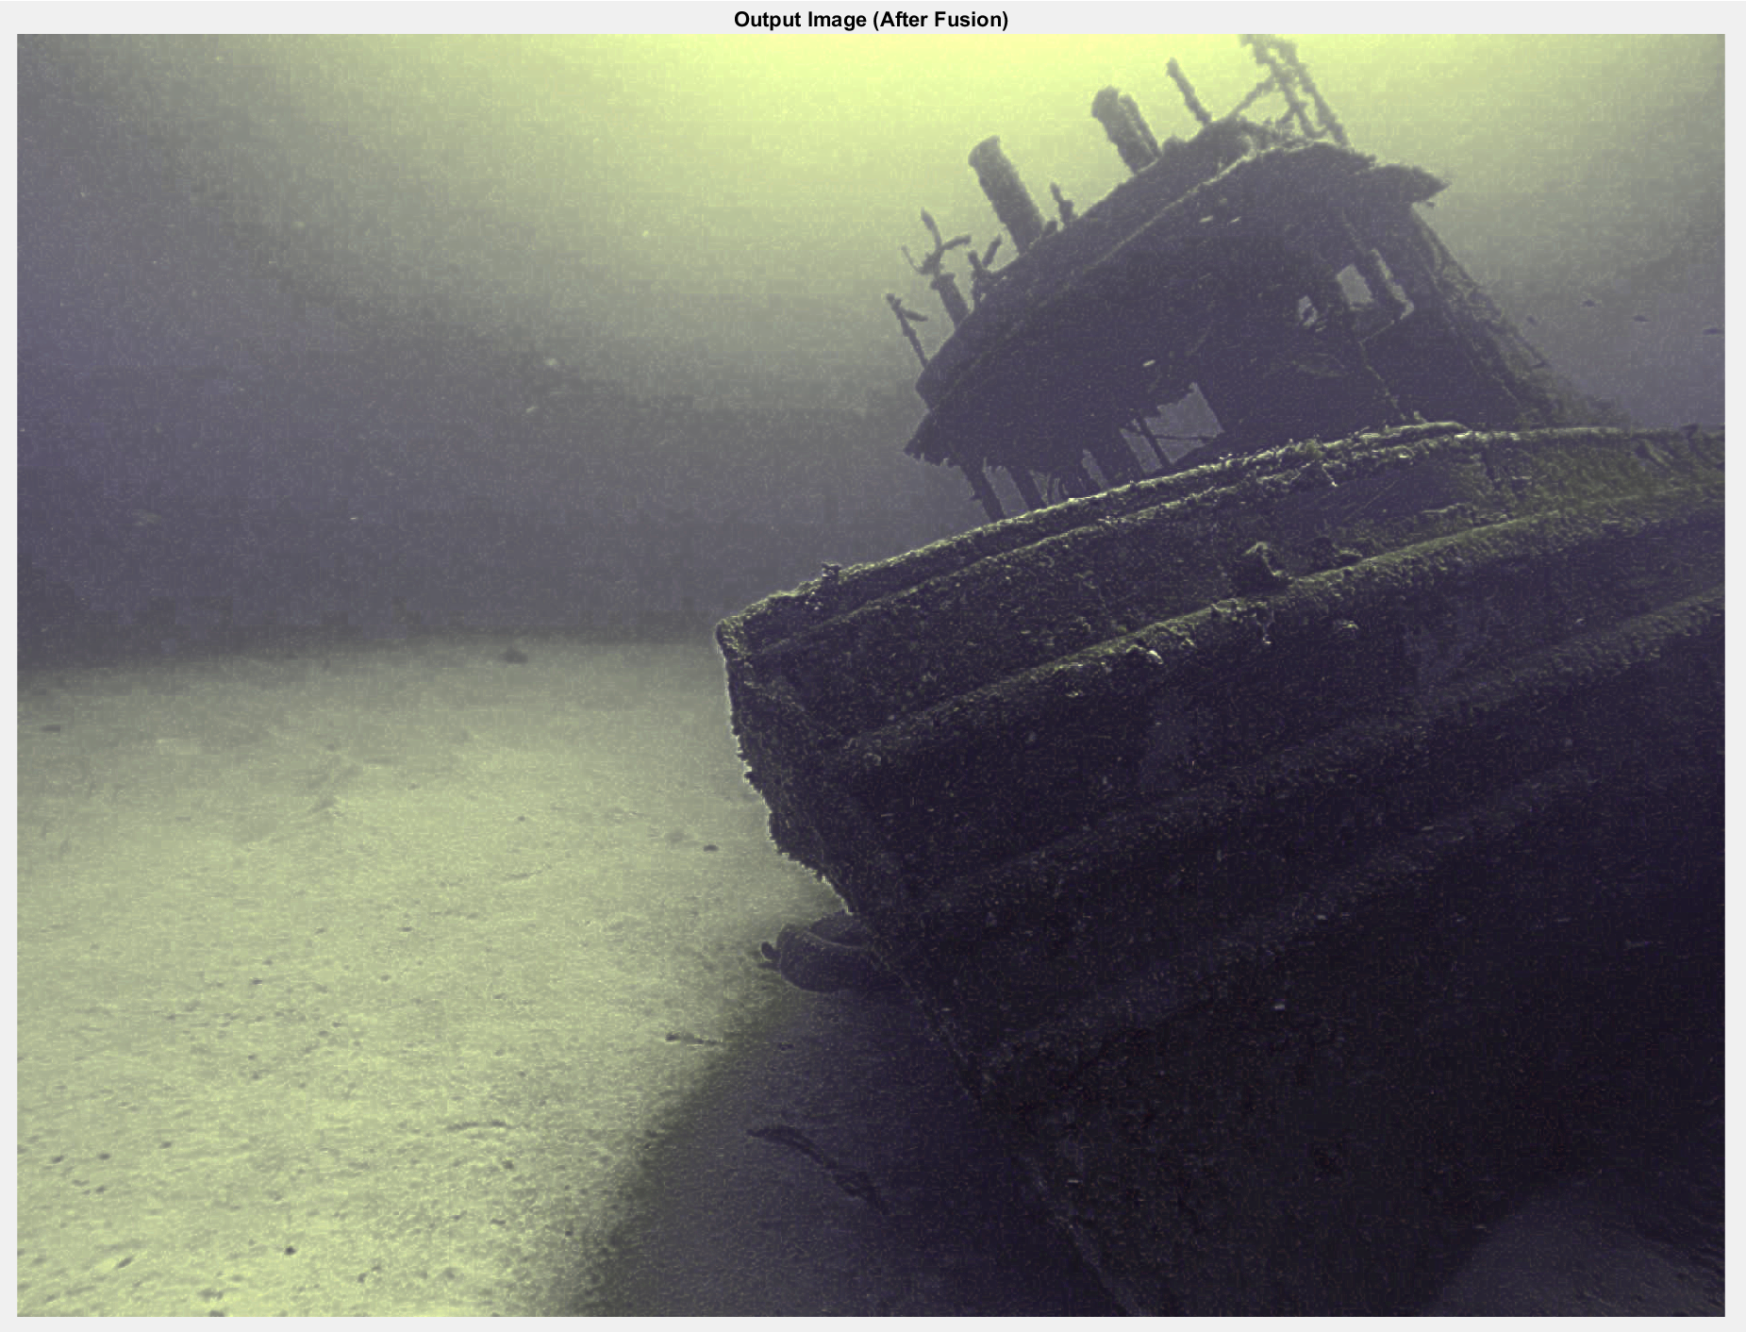
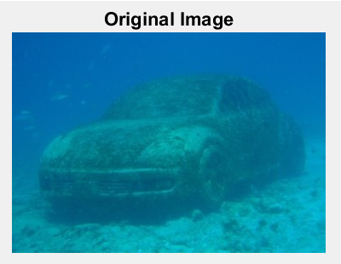
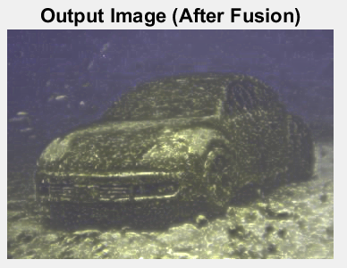
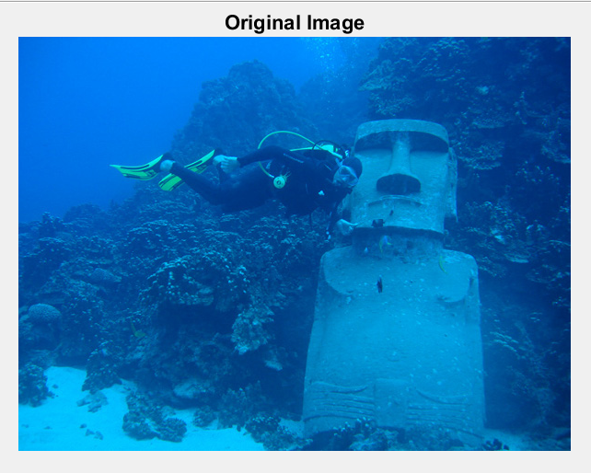
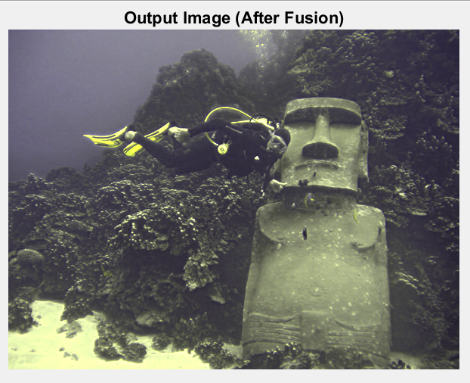
Let’s Compare

Slide 12
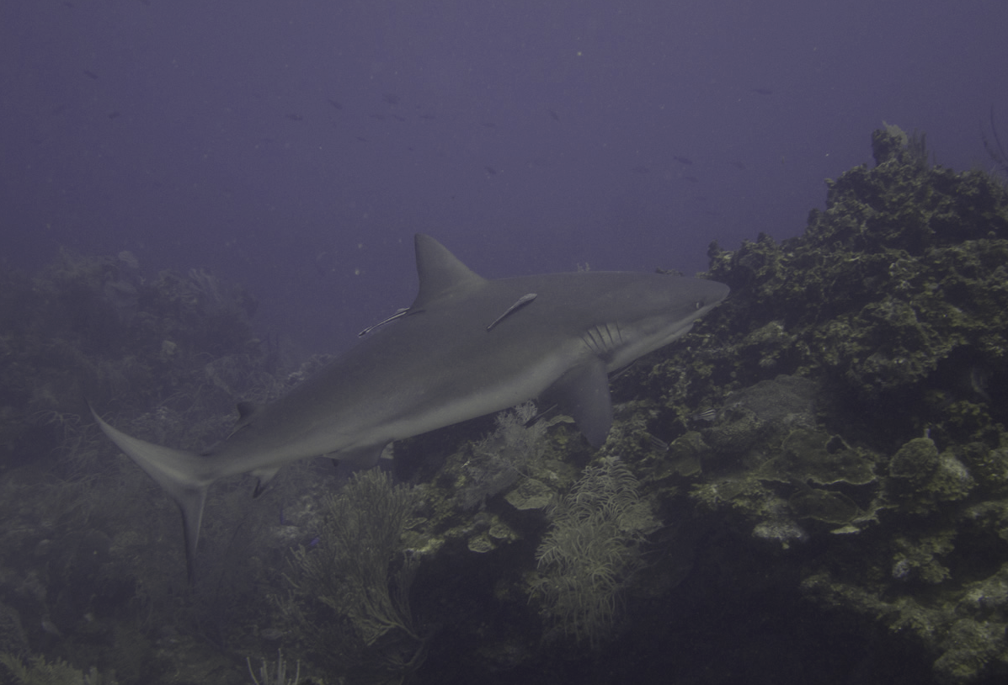
Matlab vs ours

Slide 13
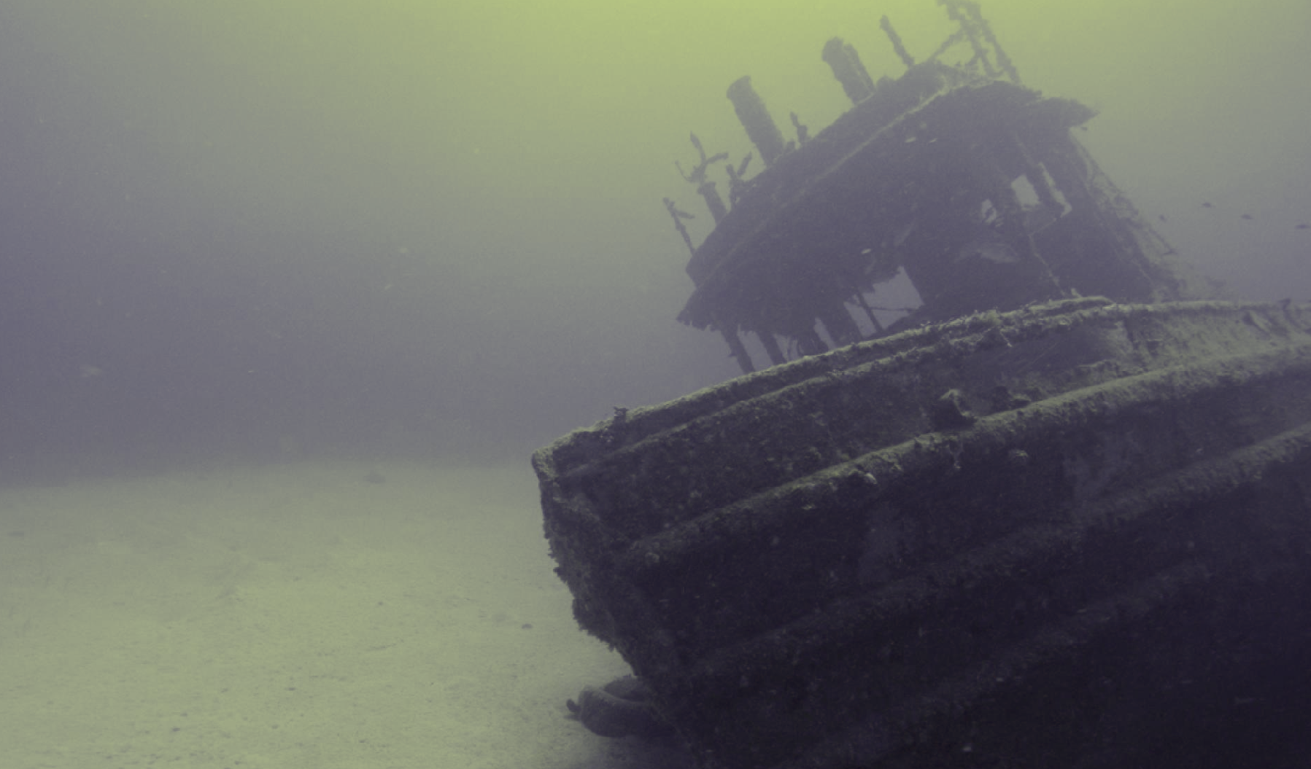
Matlab vs ours

Slide 14
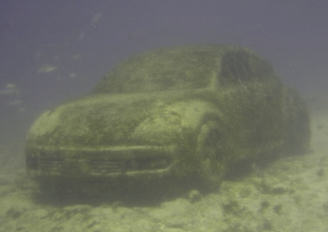
Matlab vs ours

Slide 15


Slide 16
Conclusions
Works well with high resolution images
Some parameter tweaking could improve aesthetics
Ours performed worse with human skin color

Slide 17
References
Ancuti, Codruta O. “Introduction and Overview.” Color Balance and Fusion for Underwater Image Enhancement - IEEE Journals & Magazine, IEEE
G. Buchsbaum, “A spatial processor model for object colour perception,” J. Franklin Inst., vol. 310, no. 1, pp. 1–26, Jul. 1980.
R. Achantay, S. Hemamiz, F. Estraday, and S. Susstrunk, “Frequencytuned salient region detection,” in Proc. IEEE CVPR, Jun. 2009, pp. 1597–1604.

Slide 18


